Slide 1
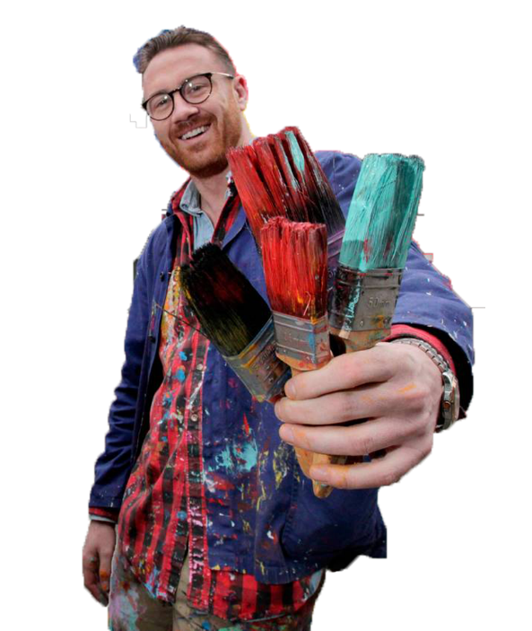
Maser
Students: Emmanuel Ogbonna (13368781) & Mark Carley (20071864)
Class Presentation: Assignment 1

Slide 2
Artist Background

Slide 3
Background to Artist himself
Originally from Dublin Ireland, real name being Al Hester before moniker ‘Maser’.
Is an Irish contemporary artist. Started as a graffiti artist in Dublin at the age of 14.
Studied Visual Communication at Art School in Dublin. Went on to establish himself as one of Ireland’s leading visual artist working in urban environments.
Has opened his own gallery space to the public on Charlemont Street on the 7th December 2018.

Slide 4
Influences to Artist

Slide 5
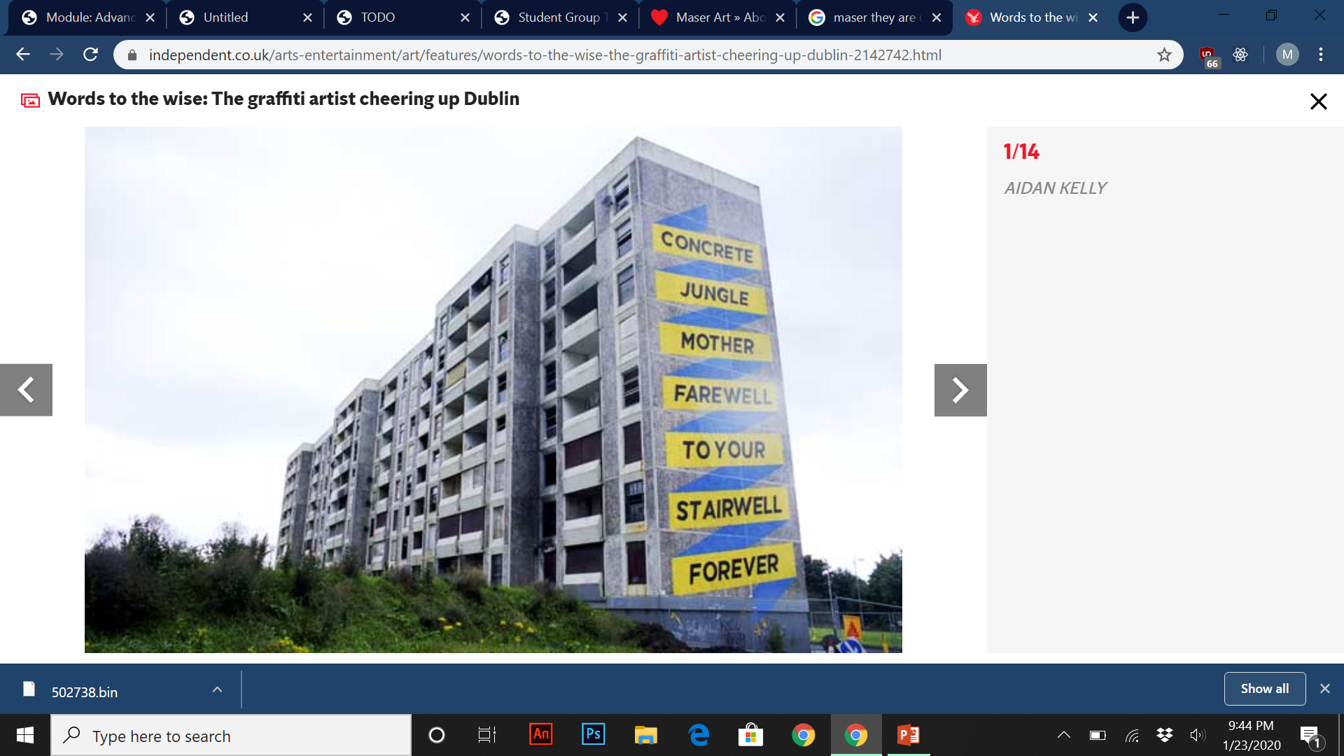
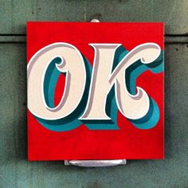
Artist Influences
Some of his earlier work “They Are Us” Project in 2010 was strongly influenced by typography, letterforms and sign painting.
Basic example of sign painting.
“They Are Us” by Maser.

Slide 6
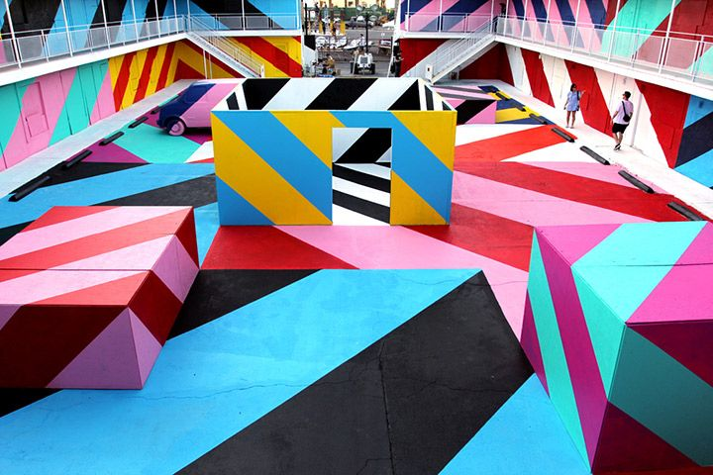
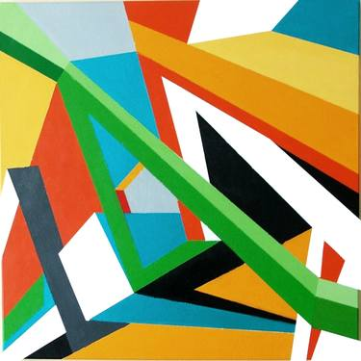
Artist Influences
Soon after 2010, Maser’s style gradually began to transition towards a graphic representation and geometric abstraction.
3D geometric abstraction painting by Marek Uhlir.
Geometric 3D street statement called “OFFSET” by Maser.

Slide 7
Artist Projects and Designs

Slide 8
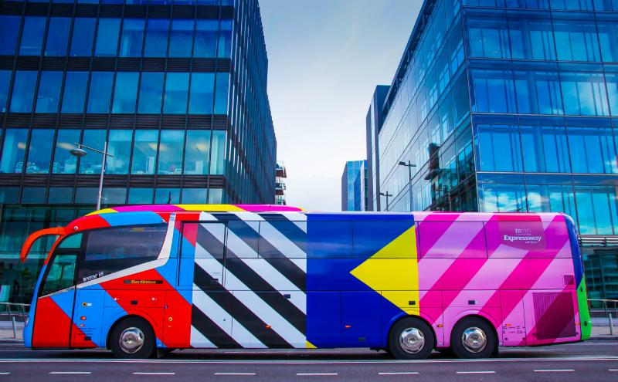
Maser Designs (ID 2015)
Expressway and Irish Design 2015 collaborated with Irish artists to create unique bus wraps. The designs were by Maser, Kevin Thornton and Orla Kiely.
Aim of the project was to demonstrate the breadth of internationally acclaimed Irish designers.
ID 2015 wrap print designs

Slide 9
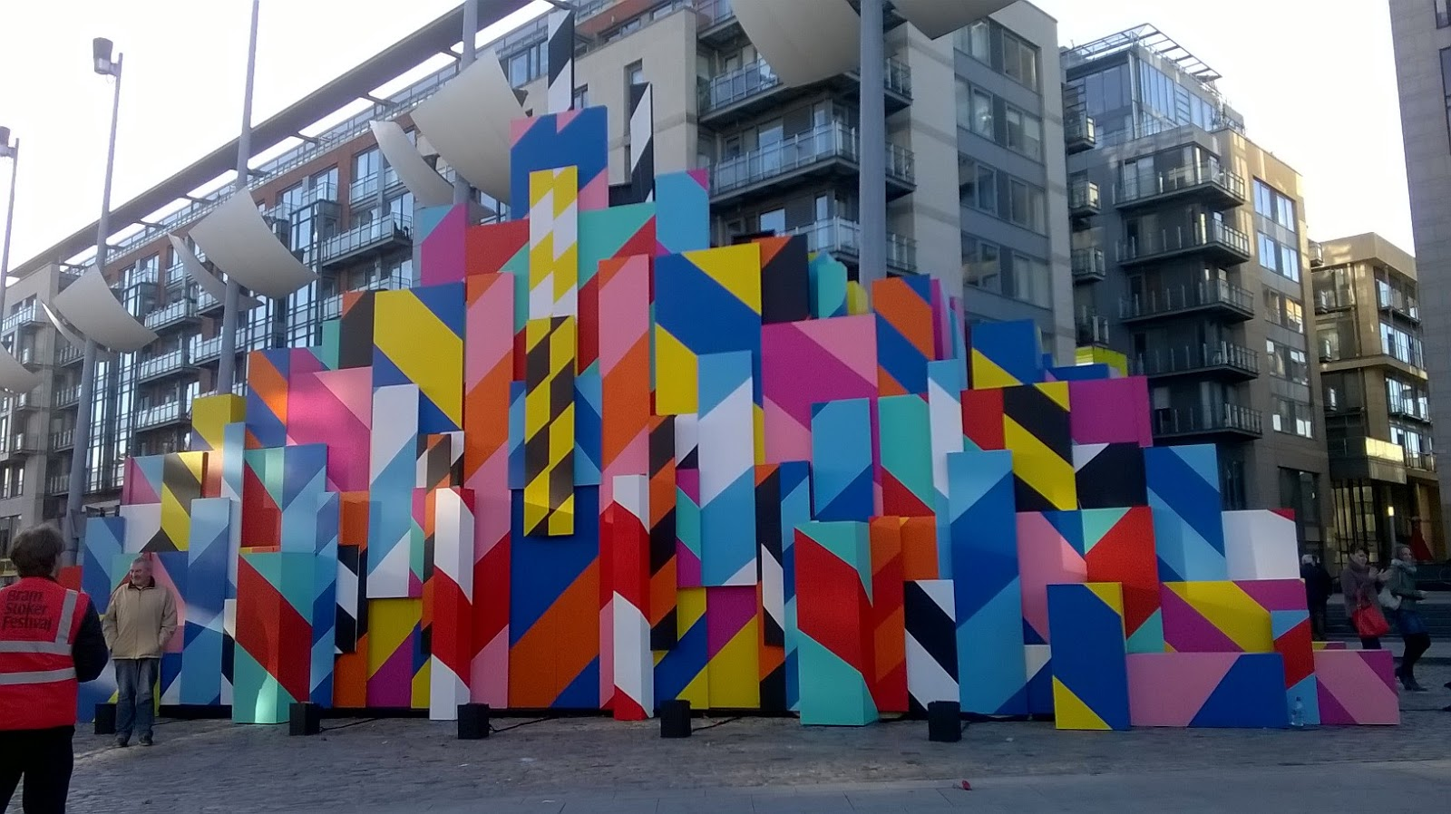
Maser Designs (Bram Stoker festival 2015)
This piece was done by Maser for the Bram Stoker festival 2015 for one weekend in October. It was setup using planks of dark wood with strobe lights with night-clubby beats.
The art piece tries to imitate patterns in cities such as roadworks, warning signs and blocks of colour against blocks of apartments.

Slide 10
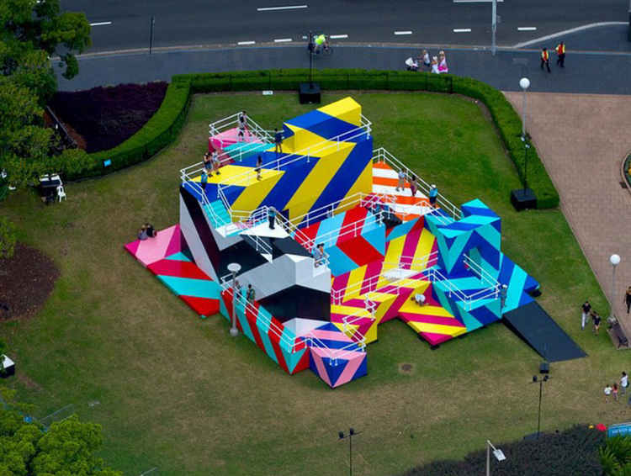
Maser Designs (OFFSET - Hyper Reality)
This piece was created at Australia’s Sydney Festival located in Hyde Park. Composed of a two-story interactive art installation titled “Higher Ground”.
Was open to the public to explore and known for a more unique, abstract style. Was inspired by the work of Dutch artist M.C. Escher.
The art piece seeks to examine the theme of impossibility and infinity.

Slide 11
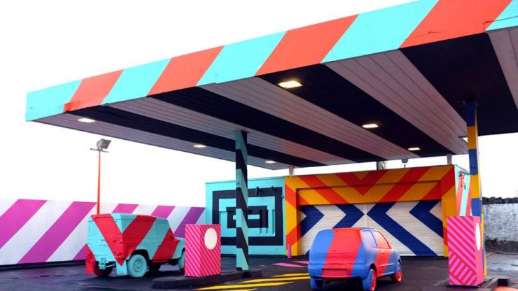
Maser Designs (No.27 – 2014)
A derelict petrol station transformed into a urban art project that’s located in Parnell Street, Limerick.
An interactive installation as part of a transformative urban art project and as a nod to “Ed Ruscha” (American artist associated with pop art movement).
Maser created the work to “surprise people and question their relationship with the familiar and the norm and also how dissociated we are from the space around us.”

Slide 12

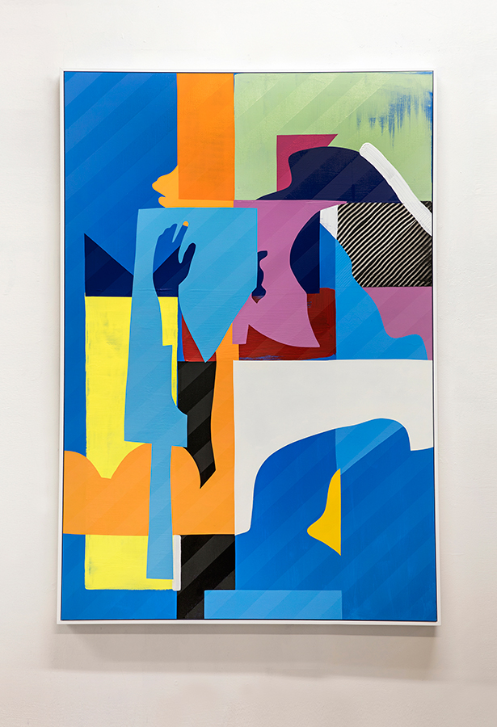
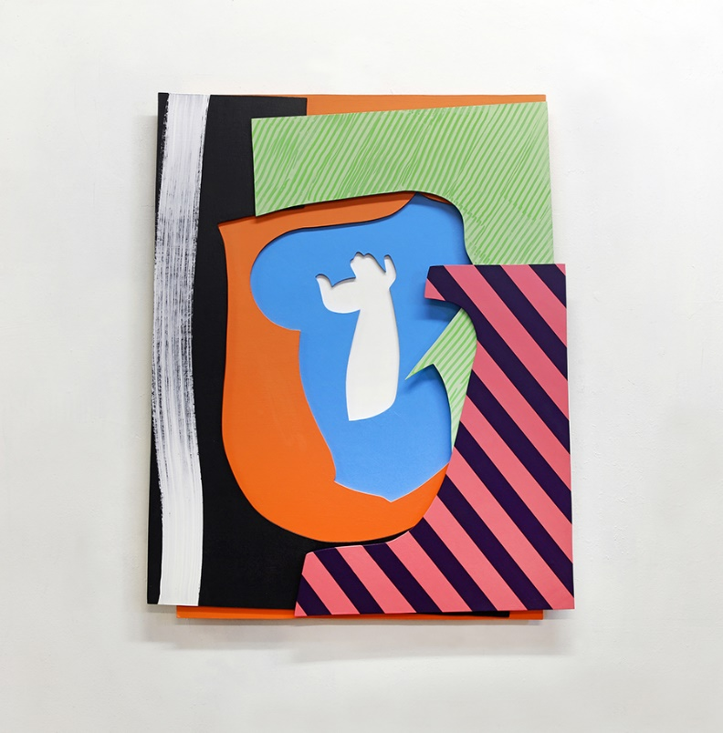
Maser Designs (Canvas pieces)
More pieces found at http://maserart.com/projects/canvas/

Slide 13
Questions

